Slide 1


INTELLIGENT ROUTE PLANNER
WITH MULTI-MODAL TRANSPORT
Team Members :
Roshan Bright R
Immanuel SA Spurgeon

Slide 2
In modern cities, people often need to combine multiple modes of transportation such as walking, cycling, buses, and metro services. Selecting an optimal multi-modal route becomes difficult when travel time, transportation cost, traffic conditions, public-transport schedules, waiting time, and user comfort need to be considered simultaneously.
Key Challenges :
PROBLEM STATEMENT
Difficulty in selecting the optimal multi-modal route.
Traffic congestion and changing travel times.
Public transport schedules and waiting time.
Balancing travel cost, time, and comfort.
Limited personalized route selection.

Slide 3
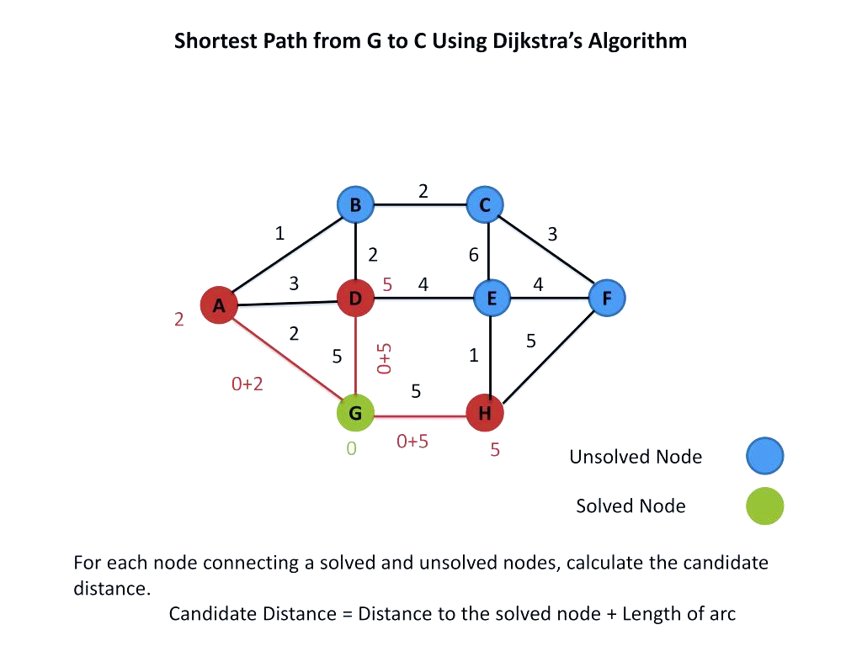
Literature Survey
1. Dijkstra's Algorithm
Finds minimum-cost paths in weighted graphs.
2. A Algorithm*
Uses heuristic estimates for efficient pathfinding.
3. Time-Dependent Routing
Considers traffic and changing travel conditions.
4. Multimodal Transportation
Combines walking, roads and public transport.
5. Research Gap
Integrating algorithms, user preferences and interactive maps.

Slide 4
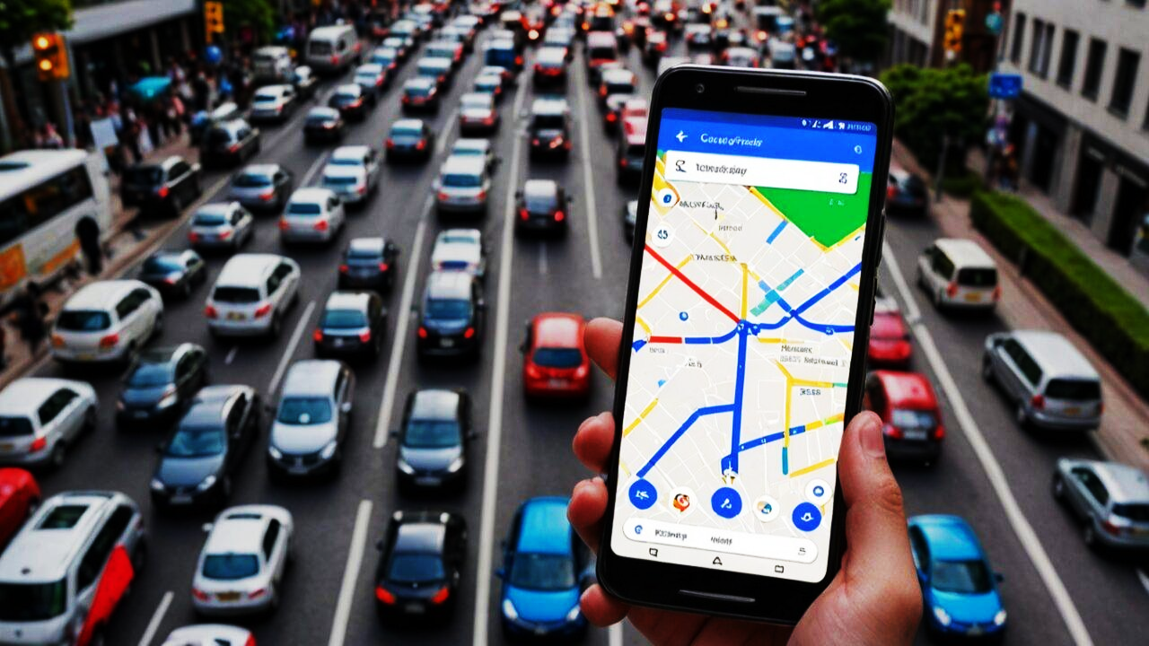
Existing System
Existing applications focus mainly on shortest or fastest routes.
Limited integration of multiple transportation modes.
Incomplete consideration of schedules and waiting time.
Limited cost, comfort and preference-based optimization.
Limited comparison of routes using multiple criteria.

Slide 5
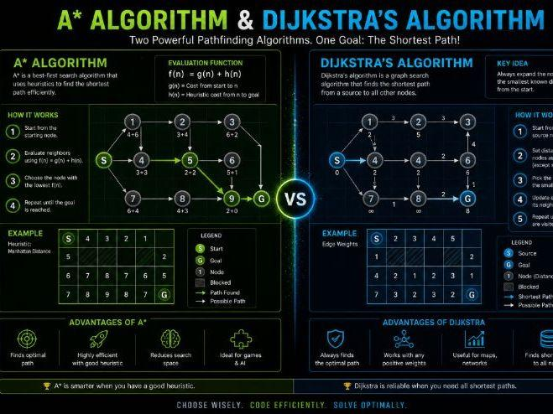
Algorithms Used
Dijkstra's Algorithm
  Minimum-cost path calculation.
  Suitable for weighted transportation graphs.
A Algorithm*
  Uses a heuristic to guide the search.
  Improves search efficiency.
Anytime Weighted A*
  Produces a good solution quickly.
  Progressively improves the solution.
Application: Multi-modal route optimization.

Slide 6
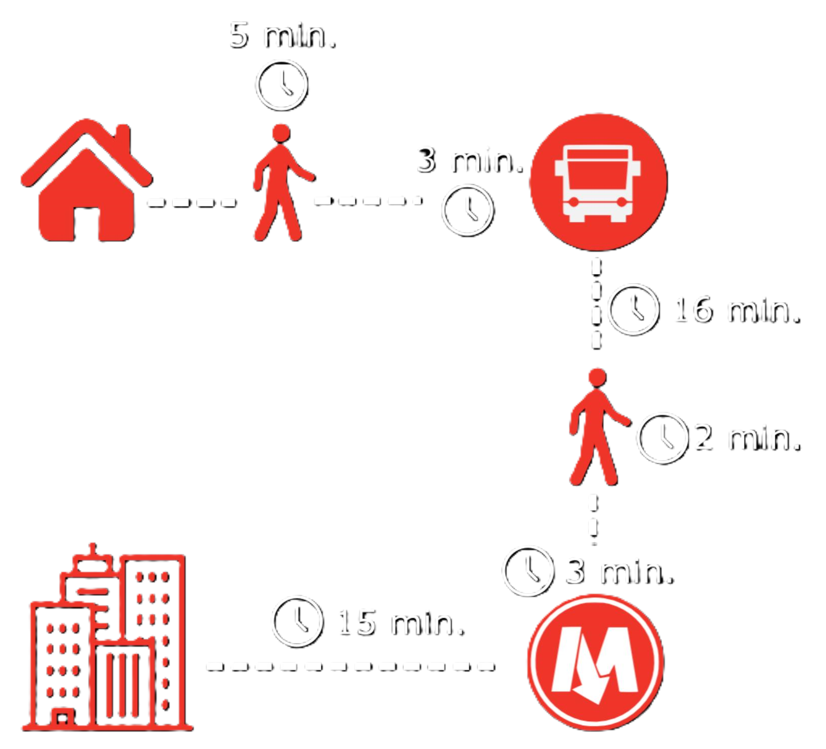
Multi-Modal Routing & Optimization
Transportation Modes:
Walking , Cycling , Bus , Car , dump truck.
Optimization Factors:
Travel time,Transportation cost,Walking distance,Waiting time,Transfers,Comfort
Route Types: Fastest | Cheapest | Comfortable | Balanced

Slide 7
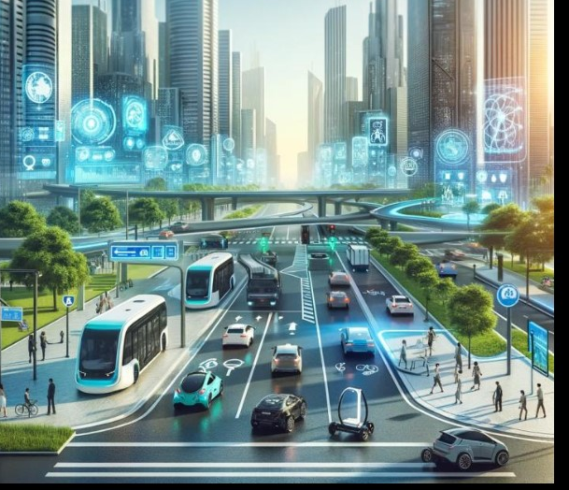
Conclusion & Future Enhancements
Conclusion
Combines multiple transport modes and intelligent algorithms.
Considers time, cost, waiting and user comfort.
Provides suitable route alternatives through map visualization.
Future Enhancements
Real-time traffic updates.
Live public-transport tracking.
Personalized route recommendations.
Accessibility-aware route planning.
Mobile application and cloud deployment.

Slide 8
THANK YOU

